Slide 1
Module 6 Guided Lab - Creating a Virtual Private Cloud
Made for Professor Lanham A. by Amrit Singh

Slide 2
AGENDA
Accessing the AWS management console
Task 1 : Creating a VPC
Task 2 : Creating subnets
Task 3 : Creating an internet gateway
Task 4 : Configuring route tables
Task 5 : Creating a security group for the application server

Slide 3
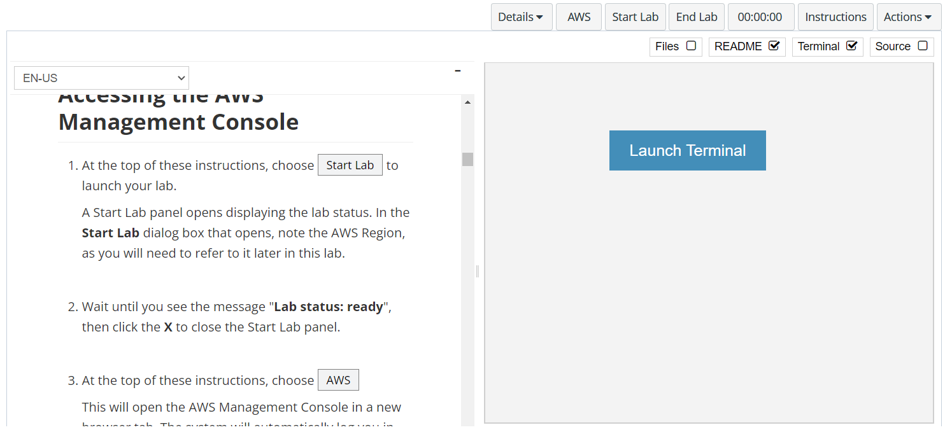
In aws labs click on start lab

Slide 4
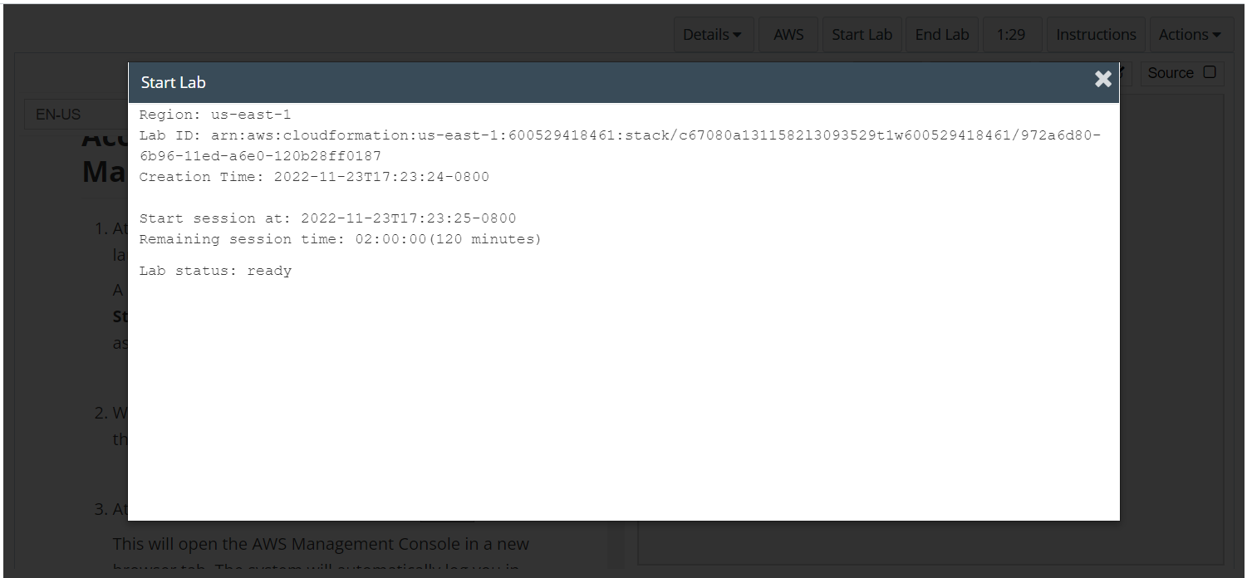
Wait to see lab ready status in the window then press x and click on aws to launch console

Slide 5
Task 1 : Creating a VPC

Slide 6
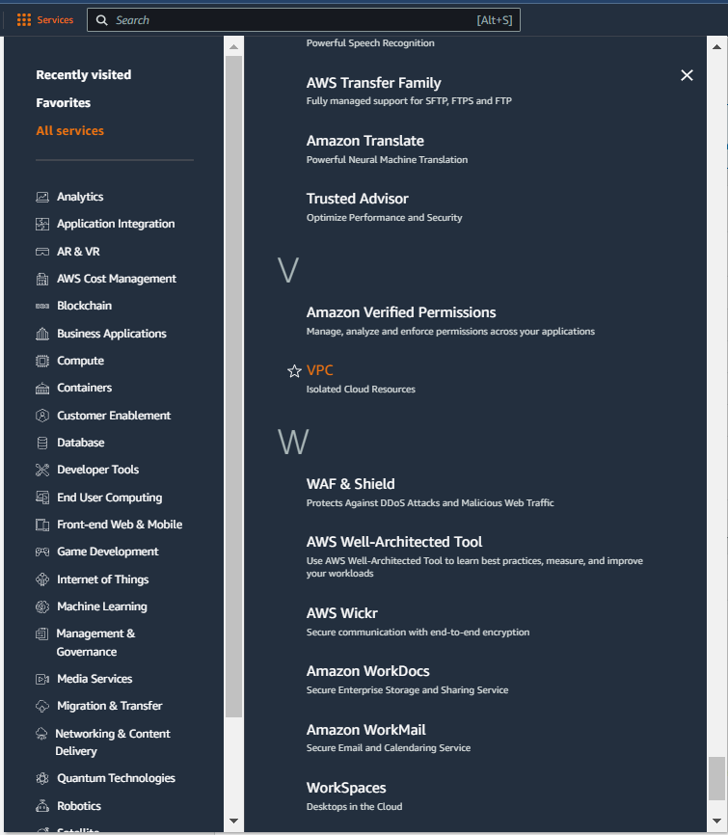
Select services and then click on VPC button
Click on the Services button
Click on the VPC button

Slide 7
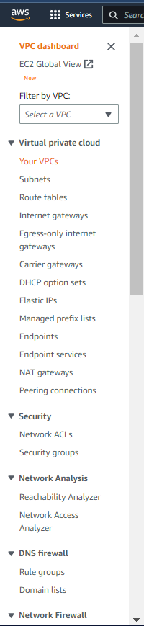
Click on YOUR VPCS button

Slide 8
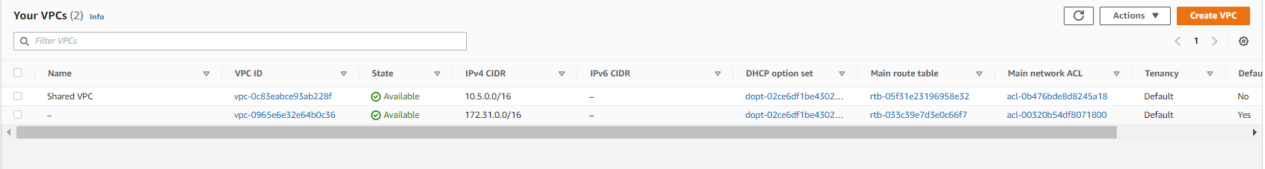
CLICK ON CREATE VPC BUTTON

Slide 9
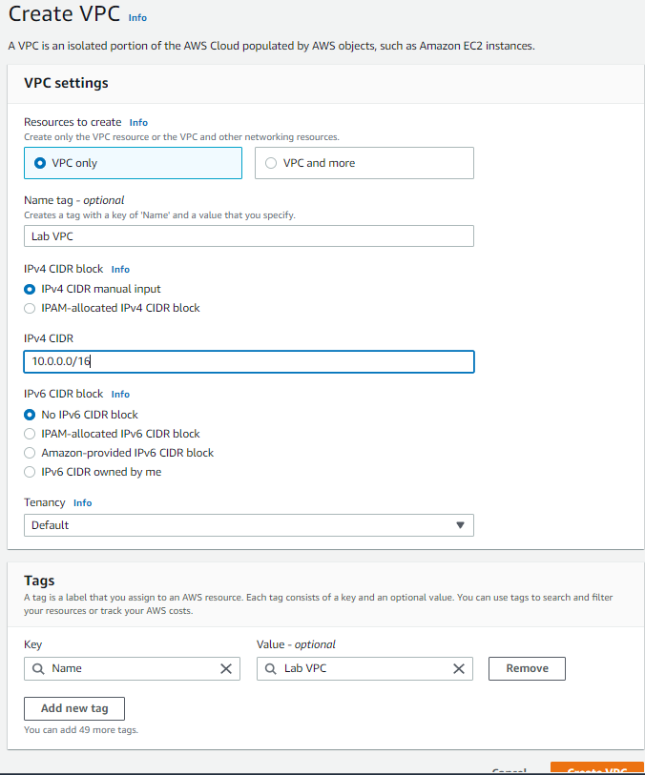
UPDATE THE VPC SETTINGS WITH lab vpc and cidr as shown in the labs

Slide 10
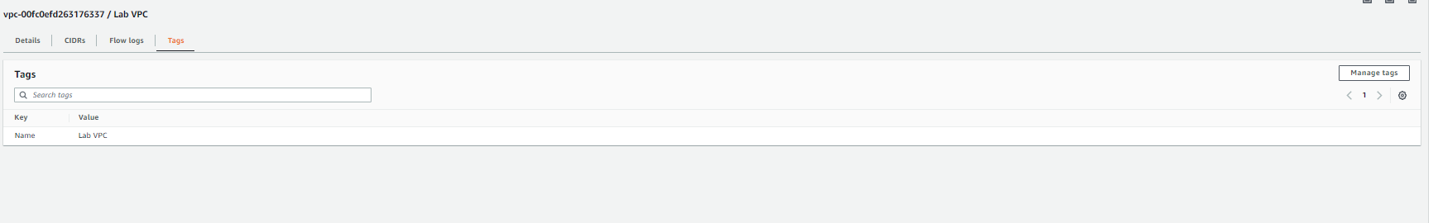
Choose tags tab to add tags for identifying resources

Slide 11
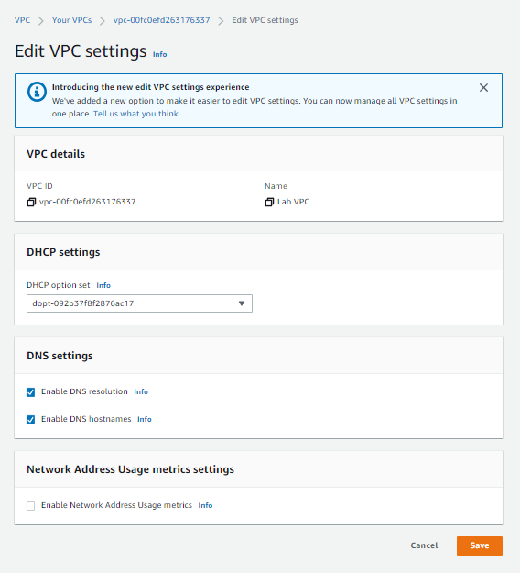
Select the la vpc > actions > edit vpc settings > check the box that says enable DNS hostnames > click save

Slide 12
Task 2 : Creating subnets

Slide 13
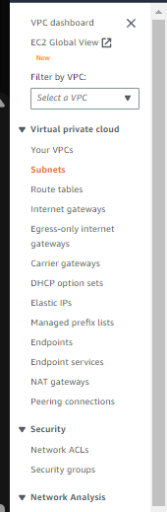
Click on subnets in the navigation pane
Click on subnets

Slide 14
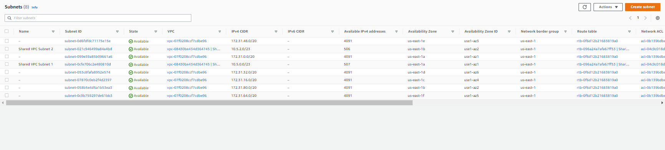
Click on create subnet button

Slide 15
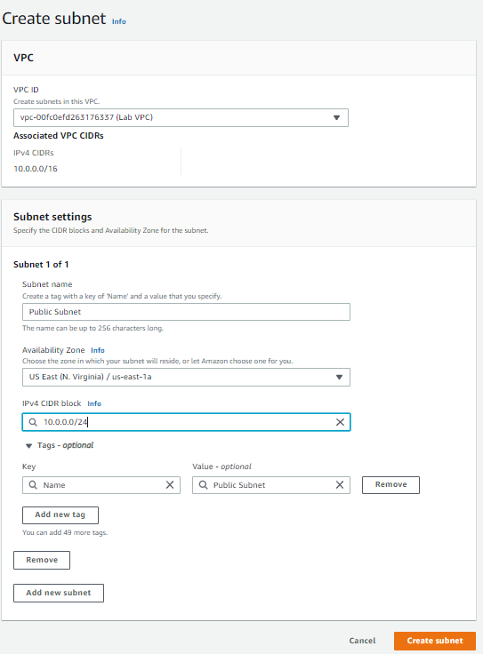
Update the subnet settings as shown and then click on create subnet

Slide 16
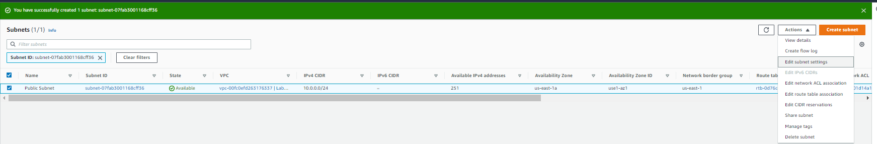
Select the subnet and then click on edit subnet settings

Slide 17
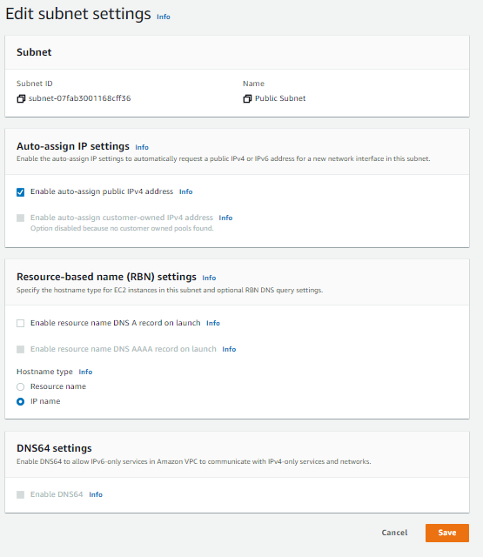
Click on enable auto assign public ipv4 address and then hit save

Slide 18
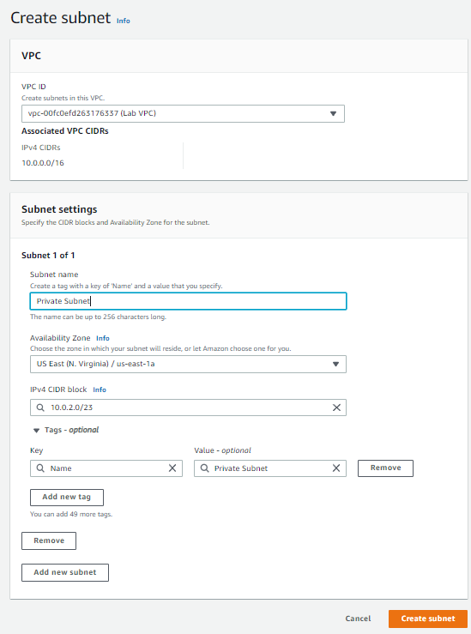
Next, create private subnet by clicking on the create subnet button on the subnet page with the details as shown below

Slide 19
Task 3 : Creating an internet gateway

Slide 20
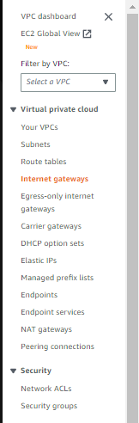
Click on internet gateways in the navigation pane
Click on Internet Gateways

Slide 21
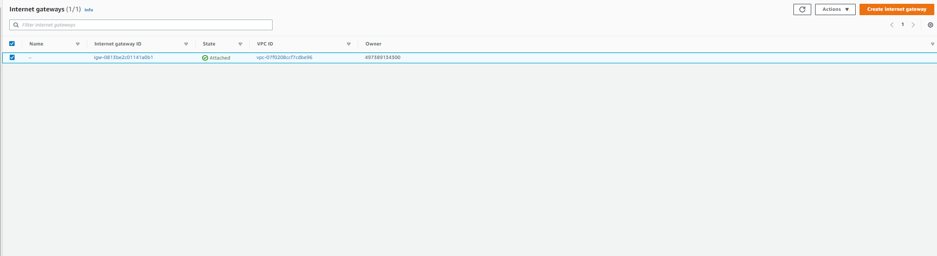
Click on create internet gateway button

Slide 22
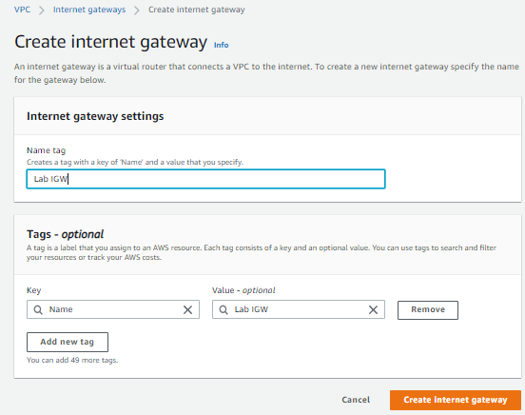
Add lab igw under name tag and click on create internet gateway

Slide 23
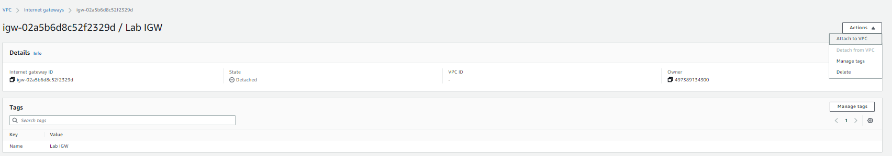
Click on actions > attach to vpc with the internet gateway selected

Slide 24
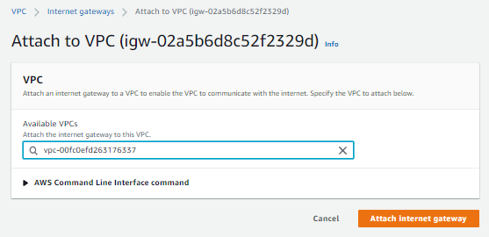
Search and select lab vpc and then click attach internet gateway

Slide 25
Task 4 : Configuring route tables

Slide 26
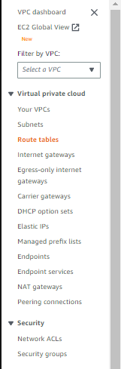
Click on route tables in the navigation pane
Click on route tables

Slide 27
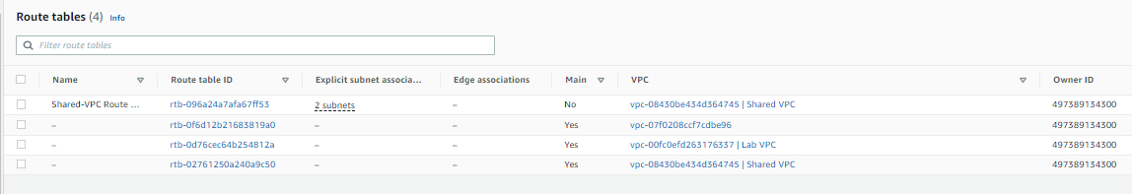
Search and select lab vpc and then click attach internet gateway

Slide 28
Expand the vpc column to identify which routes are associated with lab vpc and select the one with lab vpc

Slide 29
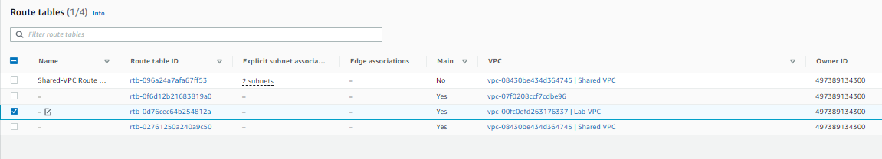
Click on the edit icon(highlighted in orange) next to the name column

Slide 30
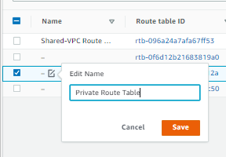
Add private route table in the edit name box and click save

Slide 31
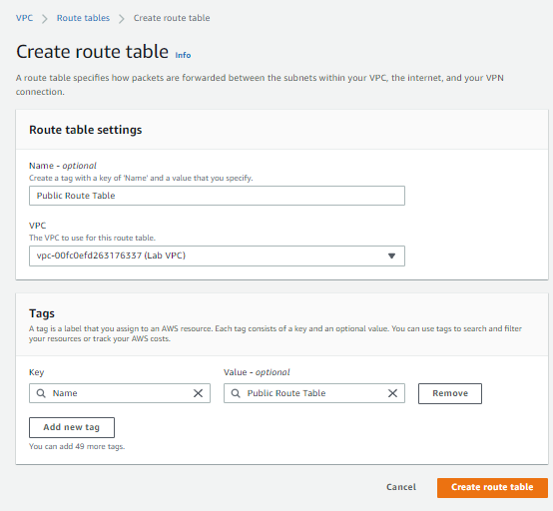
Click on create route table button and update the settings as shown and click create route table

Slide 32
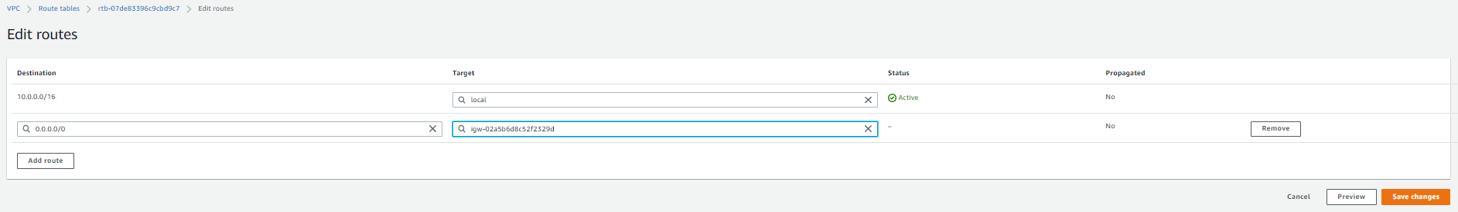
Click on edit routes in the routes tab > add route button and then configure the settings as mentioned in aws labs, then hit save changes

Slide 33
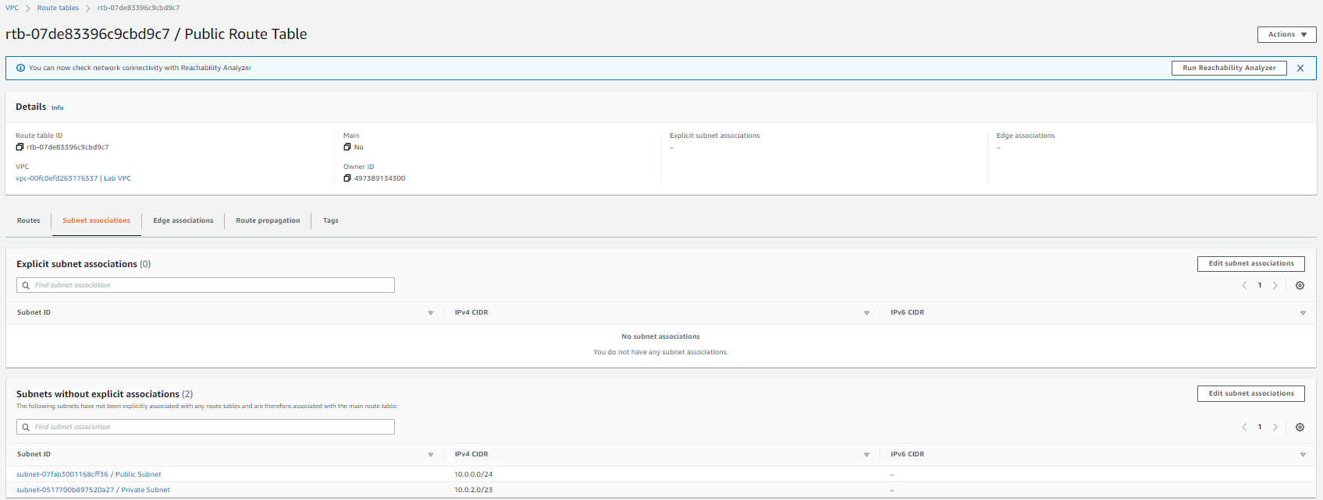
Switch to the subnet association tab and then click on edit subnet associations

Slide 34
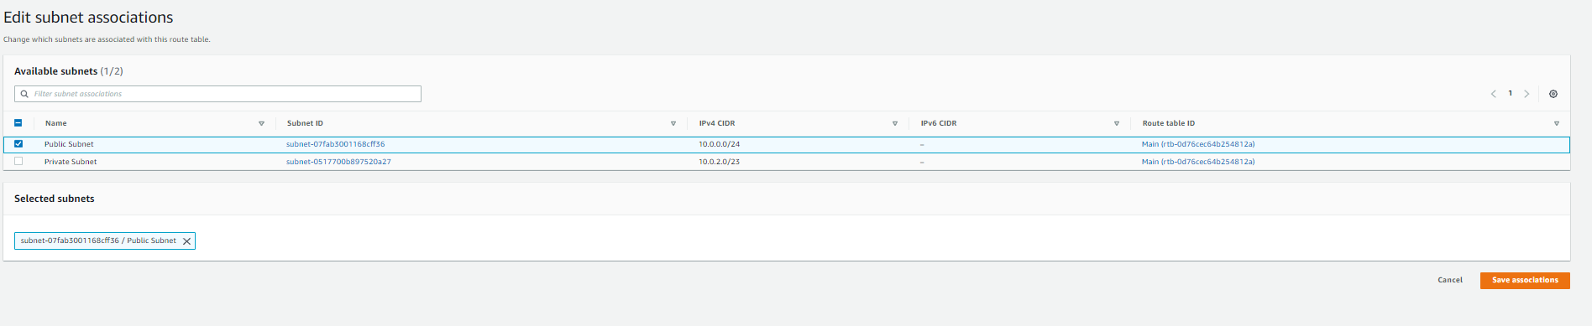
Select public subnet and then click on save associations button

Slide 35
Select public subnet and then click on save associations button

Slide 36
Task 5 : Creating a security group for the application server

Slide 37
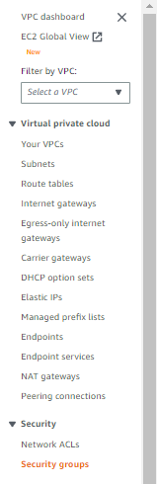
Click on security groups in the navigation pane
Click on Security Groups

Slide 38
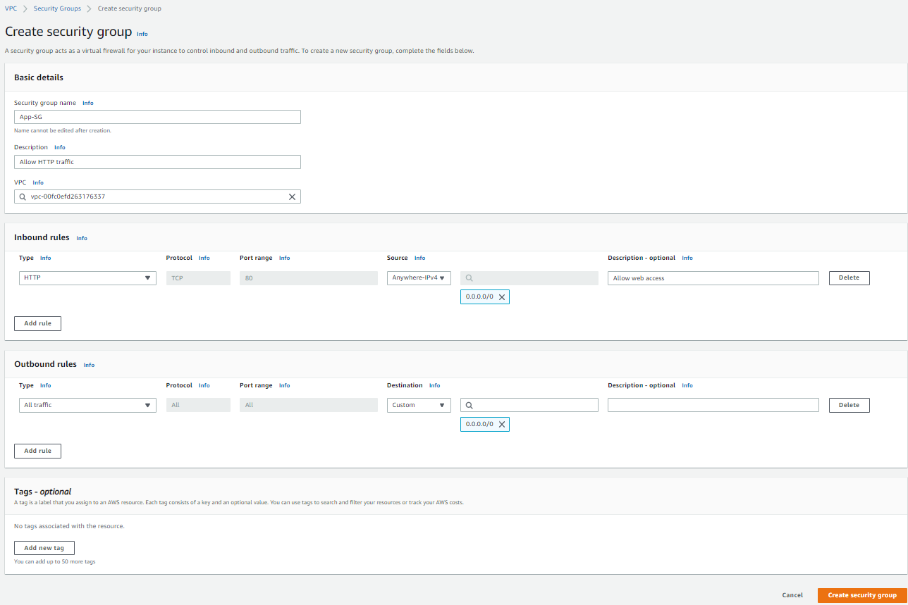
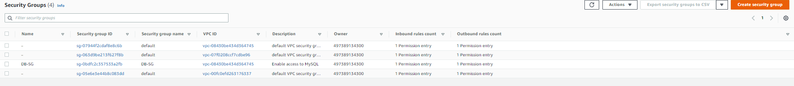
Click on create security group button

Slide 39
Configure the security group settings as shown, select the lab vpc in the vpc pane, you can add inbound rules at this step or add inbound rules separately under the inbound rules tab

Slide 40
Task 6 : Launching an application server in the public subnet

Slide 41
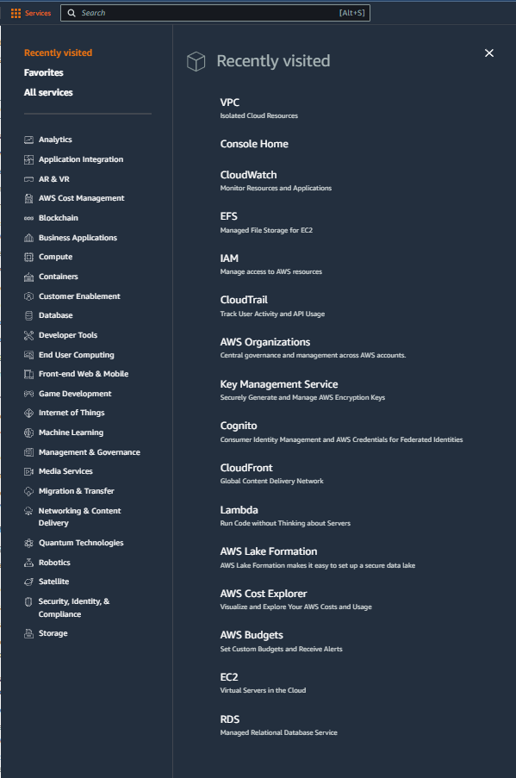
Select services and then click on EC2 button
Click on the Services button
Click on the EC2 button

Slide 42
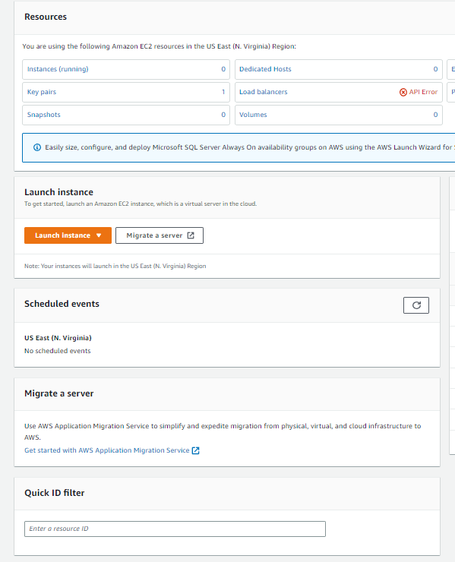
CLICK ON LAUNCH INSTANCE BUTTON AND CHOOSE LAUNCH INSTANCE

Slide 43
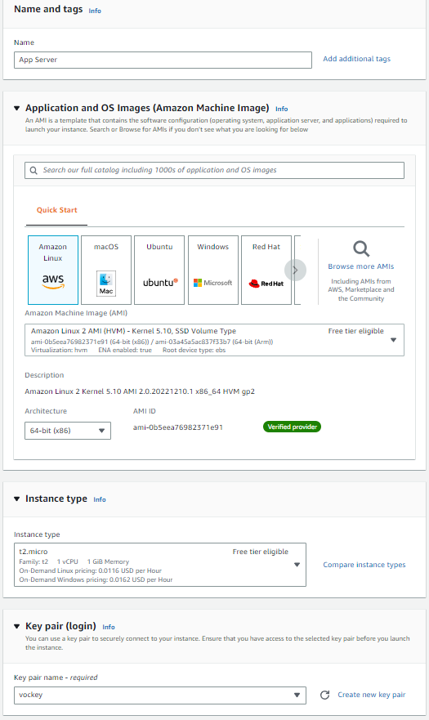
UPDATE THE NAME AND THE KEY PAIR LOGIN DETAILS AS SHOWN, REST CAN REMAIN DEFAULT

Slide 44
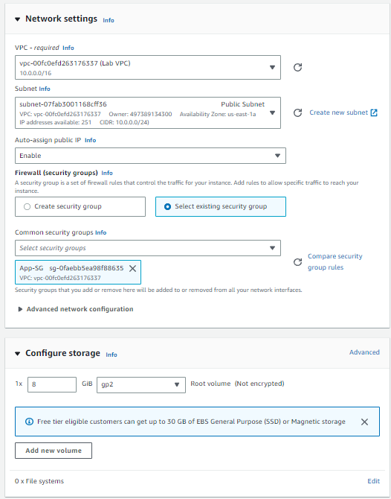
UPDATE THE VPC SETTINGS BY CLICKING ON EDIT IN THE NETWORK SETTINGS SECTION, CHOOSE LAB VPC AND PUBLIC SUBNET, CHOOSE SELECT EXISTING SECURITY GROUPS AND SELECT APP -SG

Slide 45
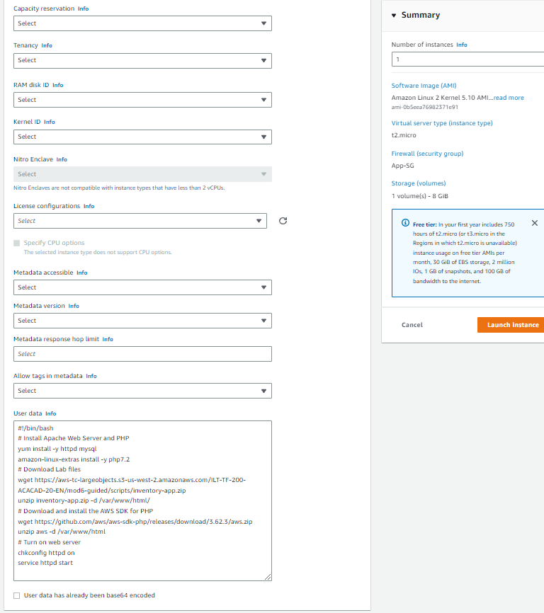
EXPAND ADVANCED SETTINGS, CHOOSE INVETORY APP ROLE UNDER IAM INSTANCE PROFILE AND ADD USER DATA AS PROVIDED IN AWS LABS CLICK ON CREATE INSTANCE

Slide 46
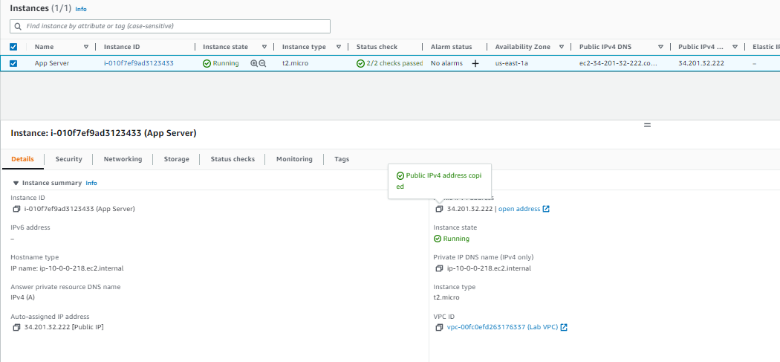
CLICK ON VIEW ALL INSTABCES AND WAIT FOR THE INSTANCE TO PASS THE HEALTH CHECKS, COPY THE PUBLIC IPV4 ADDRESS AND PASTE IT IN THE BROWSER

Slide 47
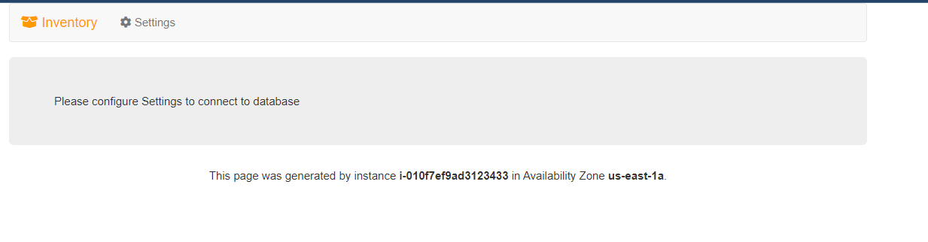
THE WEBPAGE OPENS INDICATING THAT THE VPC HAS BEEN CORRECTLY CONFIGURED

Slide 48
THANK YOU
Amrit Singh

